Slide 1


Slide 2


Slide 3


Notes:
An Adhoc network is a collection of mobile nodes, which forms a temporary network without
the aid of centralized administration or standard support devices regularly available as
conventional networks.

Slide 4

Notes:
An Adhoc network is a collection of mobile nodes, which forms a temporary network without
the aid of centralized administration or standard support devices regularly available as
conventional networks.

Slide 5



What is Rorschach Test ?
Mind’s eye
Notes:
An Adhoc network is a collection of mobile nodes, which forms a temporary network without
the aid of centralized administration or standard support devices regularly available as
conventional networks.

Slide 6

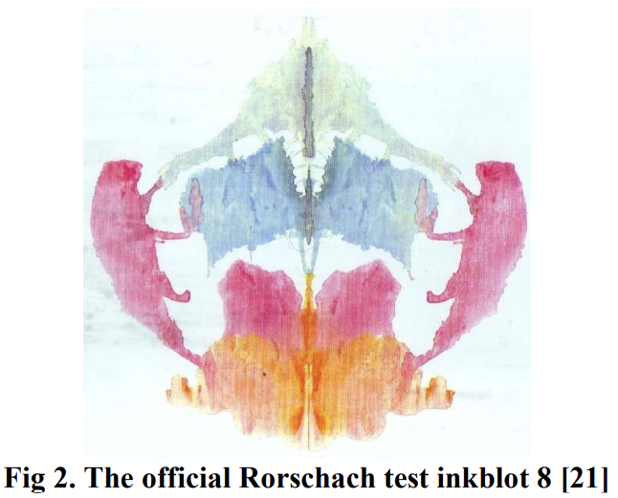
Notes:
An Adhoc network is a collection of mobile nodes, which forms a temporary network without
the aid of centralized administration or standard support devices regularly available as
conventional networks.

Slide 7

Notes:
An Adhoc network is a collection of mobile nodes, which forms a temporary network without
the aid of centralized administration or standard support devices regularly available as
conventional networks.

Slide 8

Notes:
An Adhoc network is a collection of mobile nodes, which forms a temporary network without
the aid of centralized administration or standard support devices regularly available as
conventional networks.

Slide 9

Notes:
An Adhoc network is a collection of mobile nodes, which forms a temporary network without
the aid of centralized administration or standard support devices regularly available as
conventional networks.

Slide 10
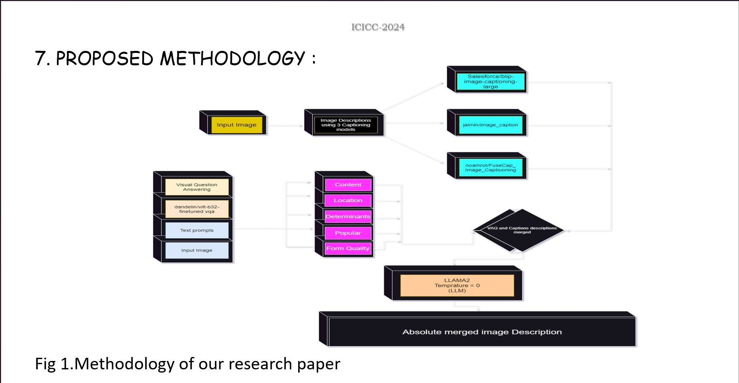
Notes:
An Adhoc network is a collection of mobile nodes, which forms a temporary network without
the aid of centralized administration or standard support devices regularly available as
conventional networks.

Slide 11


Notes:
An Adhoc network is a collection of mobile nodes, which forms a temporary network without
the aid of centralized administration or standard support devices regularly available as
conventional networks.

Slide 12
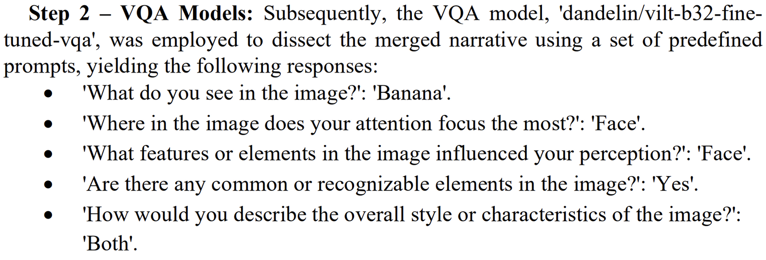
Notes:
An Adhoc network is a collection of mobile nodes, which forms a temporary network without
the aid of centralized administration or standard support devices regularly available as
conventional networks.

Slide 13
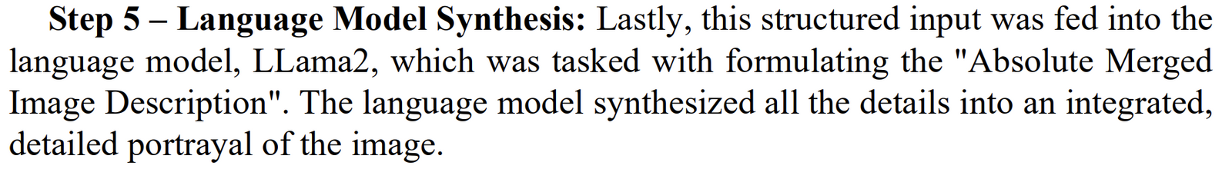

Notes:
An Adhoc network is a collection of mobile nodes, which forms a temporary network without
the aid of centralized administration or standard support devices regularly available as
conventional networks.

Slide 14
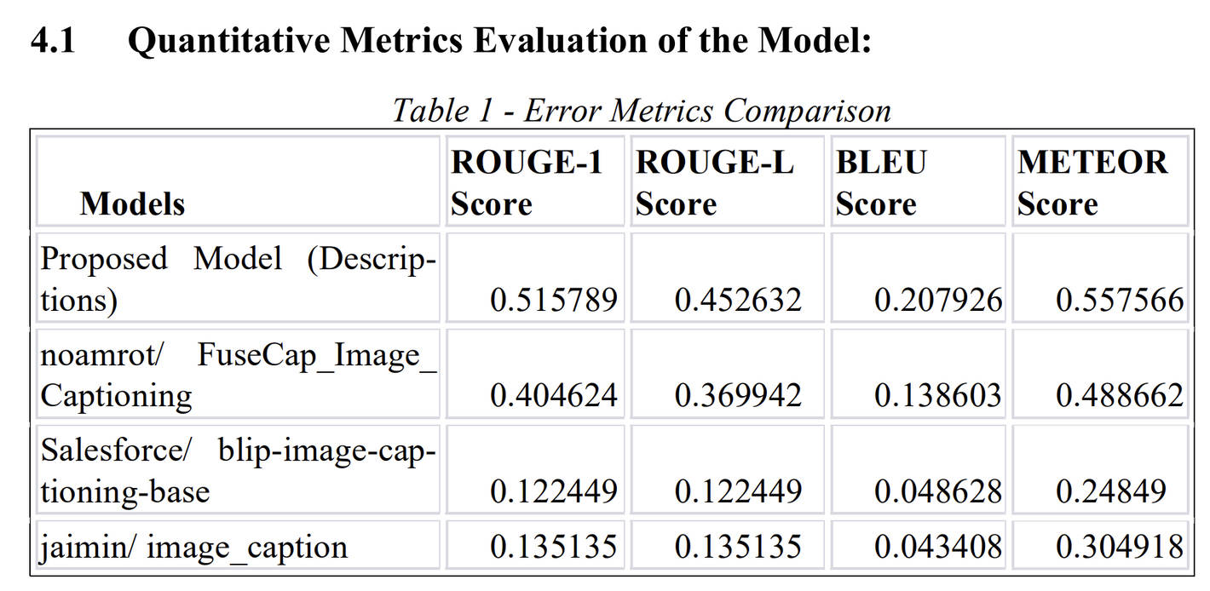
Notes:
An Adhoc network is a collection of mobile nodes, which forms a temporary network without
the aid of centralized administration or standard support devices regularly available as
conventional networks.

Slide 15

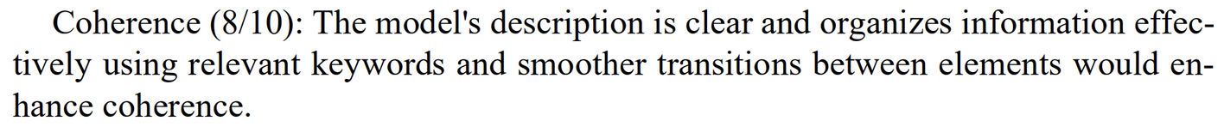
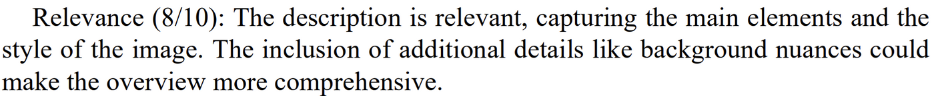
Notes:
An Adhoc network is a collection of mobile nodes, which forms a temporary network without
the aid of centralized administration or standard support devices regularly available as
conventional networks.

Slide 16

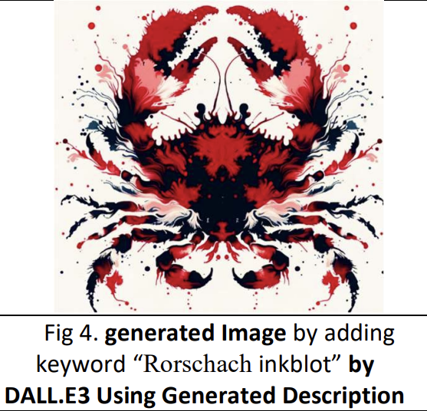
Notes:
An Adhoc network is a collection of mobile nodes, which forms a temporary network without
the aid of centralized administration or standard support devices regularly available as
conventional networks.

Slide 17

Notes:
An Adhoc network is a collection of mobile nodes, which forms a temporary network without
the aid of centralized administration or standard support devices regularly available as
conventional networks.

Slide 18


Notes:
An Adhoc network is a collection of mobile nodes, which forms a temporary network without
the aid of centralized administration or standard support devices regularly available as
conventional networks.

